Slide 1
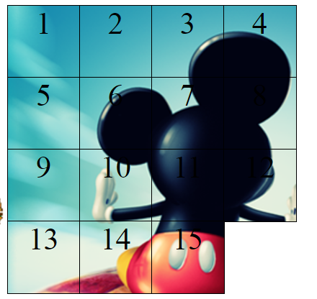
15 Puzzle
Basheerah K
Amna Anwar
Viral Barot

Slide 2
Front-End (Amna)
CSS GIFs
Puzzle Background
Other backgrounds dropdown
Animations

Slide 3
Back-End (Basheerah and Viral)
Making pieces slide correctly
Moves/Timer
Shuffle

Slide 4
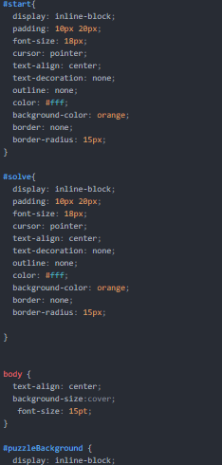
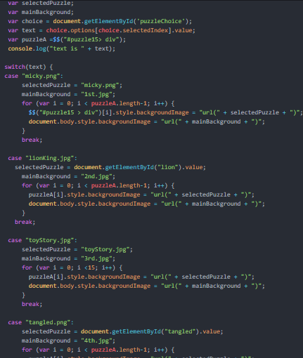
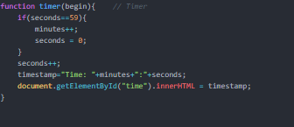
CODE

Slide 5
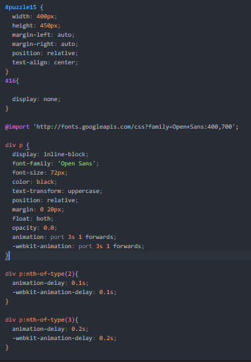
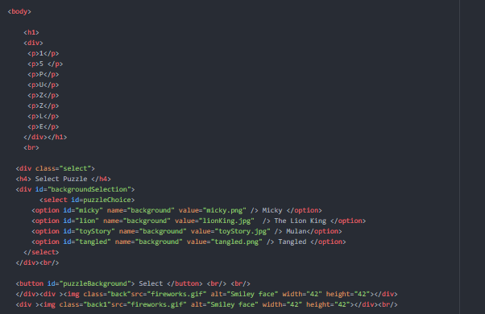
CODE

Slide 6
Demo
http://codd.cs.gsu.edu/~bsabree1/projects/puzzle15/fifteen.html

